Slide 1
Weather Application
Requirements, preparation and implementation

Slide 2
Requirements
A weather forecasting single page application that consists of:
A Landing Page that:
1) Detects user’s location.
  2) Displays the weather for that location.
  3) Has a search bar to access other cities.
A City Weather Dashboard that:
1) Shows detailed weather information for the selected city.
2) Shows historical weather information for that city.

Slide 3
Preparation (Wireframes and General Ideas For The Page)
For the landing page display the user sees:
A summary for the weather conditions of their detected city (using geolocation).
A search bar for the user to navigate to another city and see its weather conditions.
Below the weather card, there’ll be the weather maximum and minimum temperatures for that week.
The user can click on the “Weather Details” button or on the city name to navigate to the dashboard display.

Slide 4
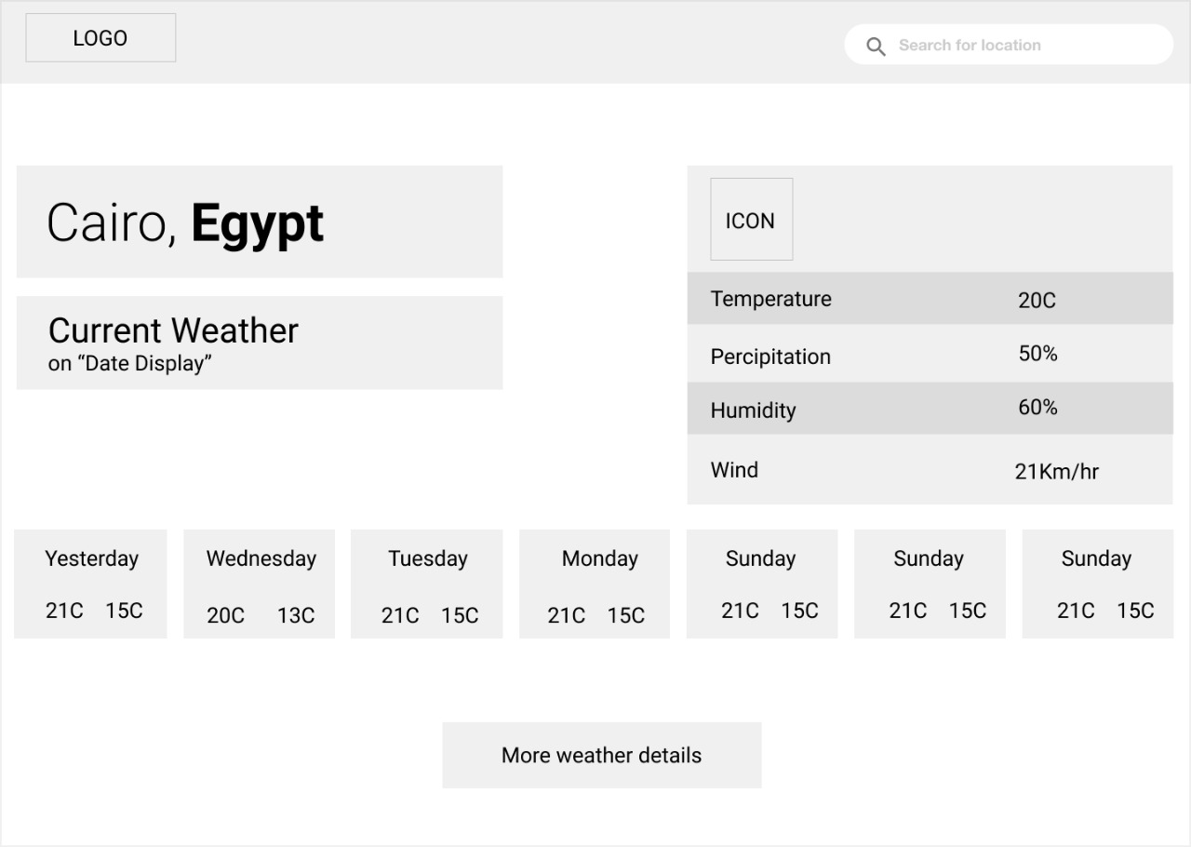
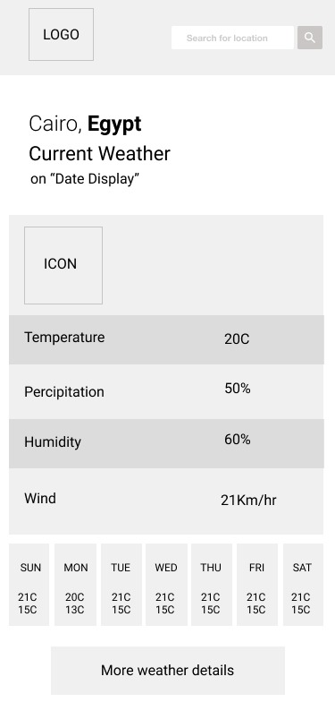
These are the wireframes for the landing display for both the desktop and mobile view:

Slide 5
Preparation (Wireframes and General Ideas For The Page)
For the weather dashboard display:
The page will show two data representation figures:
A graph of the temperature every 3 hours on that day of the city selected or searched by the user.
A bar chart of the average temperature for every day on the week.
Below these figures, there’ll be a weather card that at first shows a
summarized weather conditions that also has a date picker for the user to choose a specific date to see its weather.

Slide 6
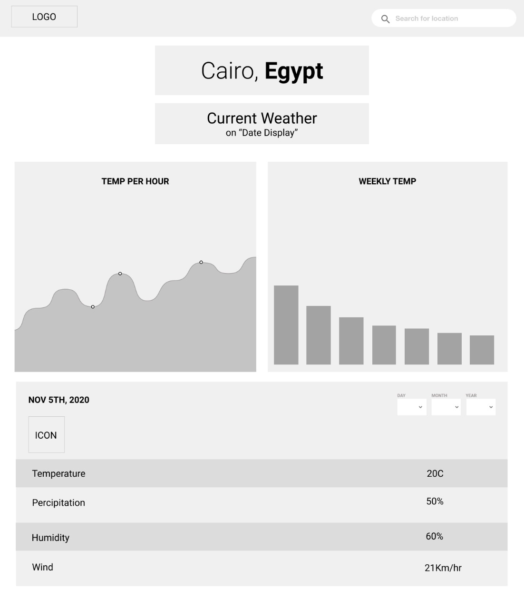
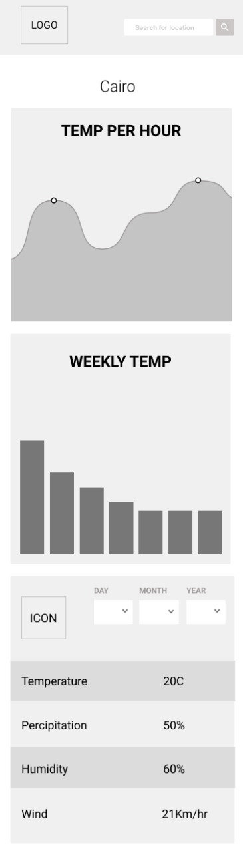
These are the wireframes for the weather dashboard display for both the
desktop and mobile view:

Slide 7
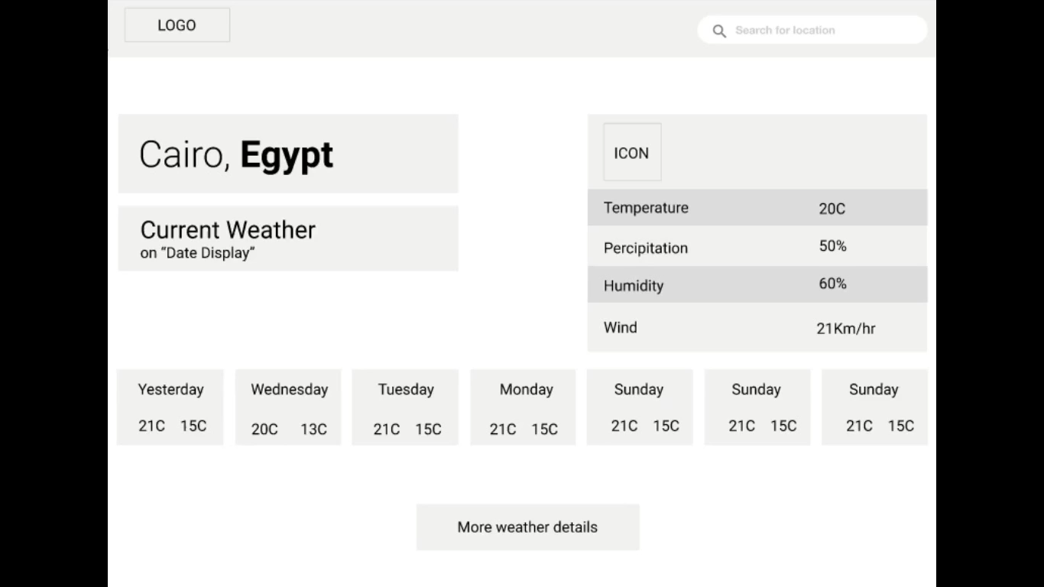
This is a video walkthrough of the application

Slide 8
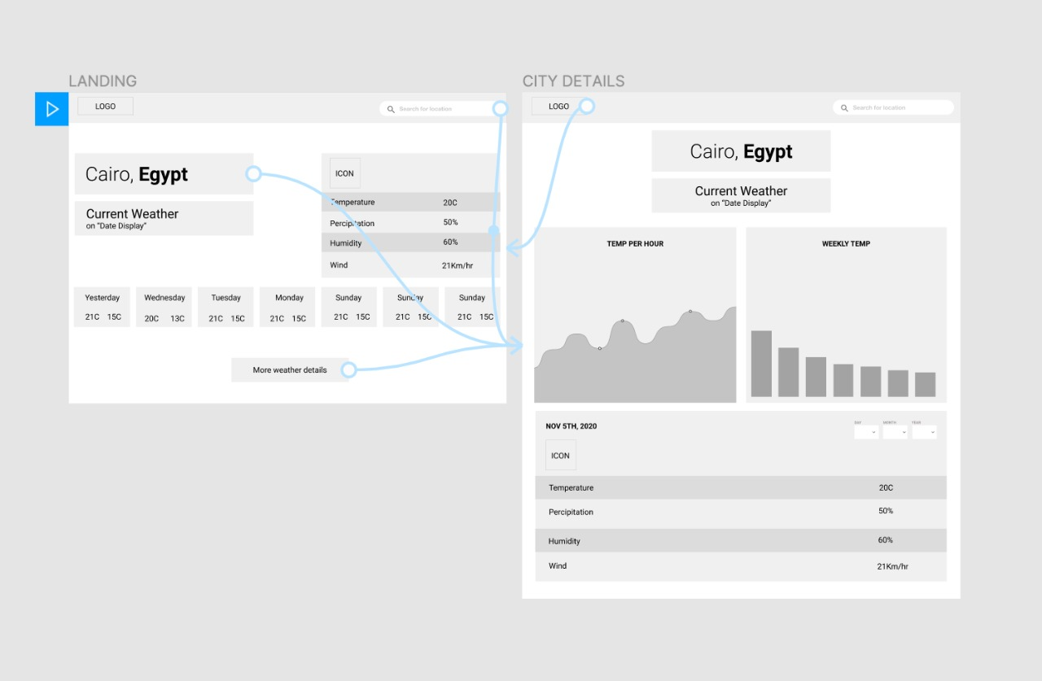
Prototype of the user Interactions with the application:

Slide 9
Preparation and Implementation (Basic Architecture)
There’ll be the root component (App Component) which will have 3 child components (Header Component, Landing-View Component, Dashboard-View Component).
Some shared components also will be implemented like (Weather-Card Component and Error-Handling Components).
There’ll be some services (Get-Location Service and Get-Weather Service).

Slide 10
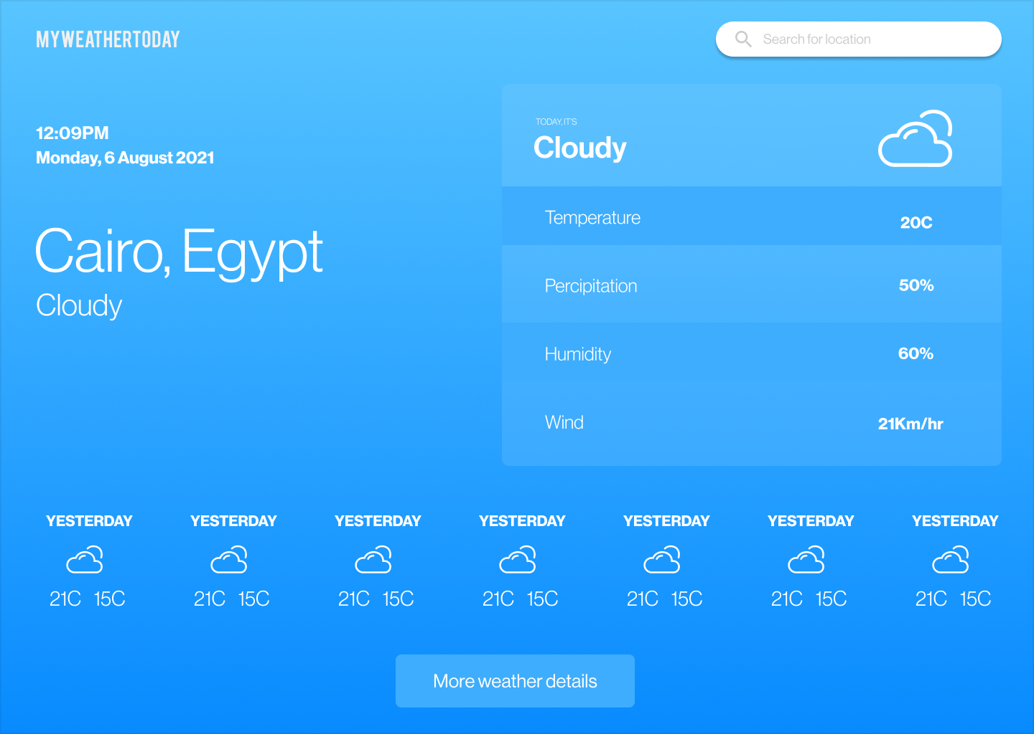
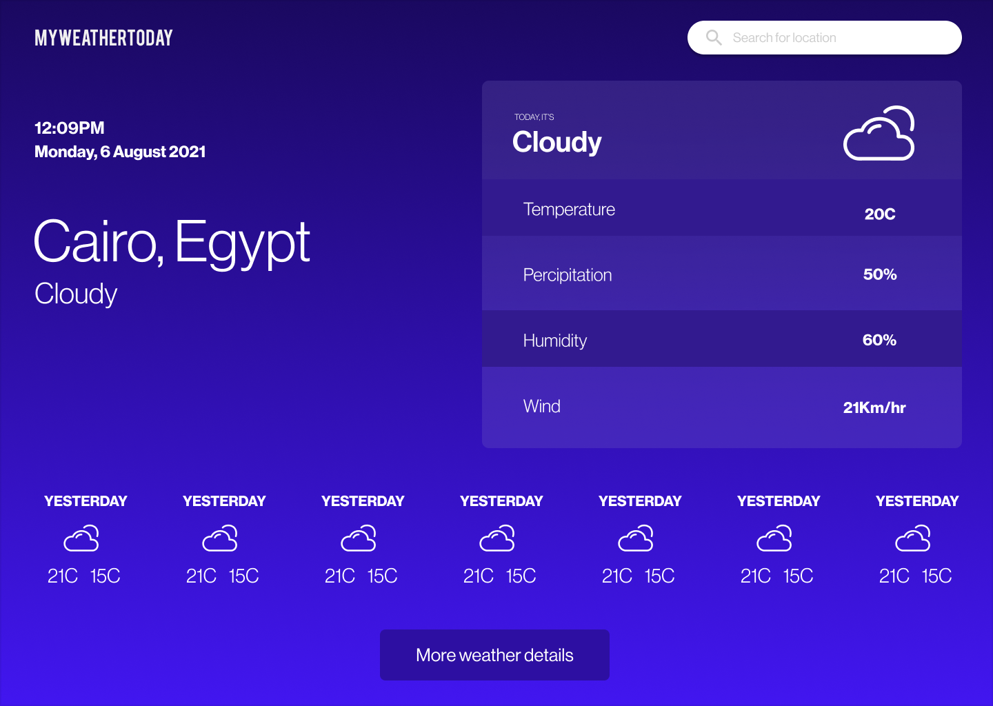
Possible additional functions that could be implemented later.
- A day and night feature that will dynamically change based on the time of the day.

Slide 11
Thank You.
Khaled Mohamed

